Slide 1
Crawling using Scrapy
IST 441 - Fall 2021
Shaurya Rohatgi
PhD Candidate, IST

Slide 2
Overview and Goals
Understanding Scrapy
Structure of Project in Scrapy
Getting URL’s contents and storing them
Getting URLs from Common Crawl

Slide 3
Prerequisites :
Understanding HTTP Status Codes
Status codes are issued by a server in response to a client's request made to the server
110 - Connection timed out
200 - Success
404 - Not Found
https://en.wikipedia.org/wiki/List_of_HTTP_status_codes

Slide 4
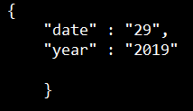

Prerequisites :
JSON and JL - formats for document store
.json - is a minimal, readable format for structuring data. It is used primarily to transmit data between a server and web application.
JL - json lines
Every line is a json. Great for streaming data and easy for appending new jsons
http://jsonlines.org/

Slide 5
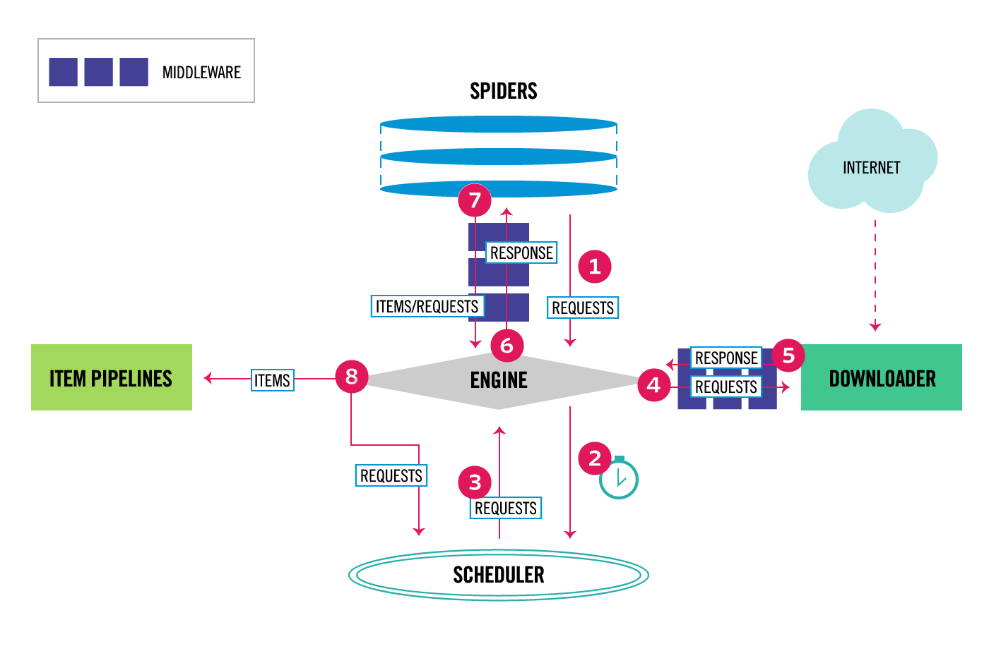
Scrapy Architecture
The Engine gets the initial Requests to crawl from the Spider.
The Engine schedules the Requests in the Scheduler and asks for the next Requests to crawl.
The Scheduler returns the next Requests to the Engine .
The Engine sends the Requests to the Downloader, passing through the Downloader Middlewares (see process_request()).
Once the page finishes downloading the Downloader generates a Response (with that page) and sends it to the Engine, passing through the Downloader Middlewares (see process_response()).
The Engine receives the Response from the Downloader and sends it to the Spider for processing, passing through the Spider Middleware (see process_spider_input()).
The Spider processes the Response and returns scraped items and new Requests (to follow) to the Engine , passing through the Spider Middleware (see process_spider_output()).
The Engine sends processed items to Item Pipelines, then send processed Requests to the Scheduler and asks for possible next Requests to crawl.
The process repeats (from step 1) until there are no more requests from the Scheduler .
Source - Architecture overview — Scrapy 2.4.1 documentation

Slide 6
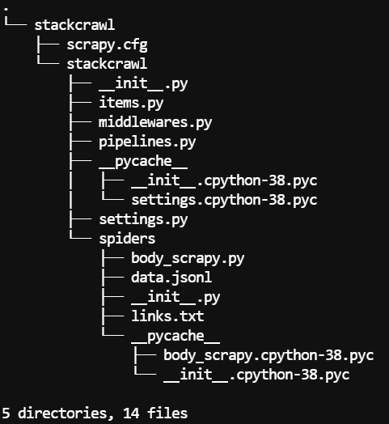
Starting a Project in Scrapy
1
scrapy startproject stackcrawl
Creates Project files and directories
https://doc.scrapy.org/en/latest/intro/tutorial.html

Slide 7
Let’s Crawl !

Slide 8
Instructions to access on IST441 server
● Access to VLABS at https://svg.up.ist.psu.edu from browser
● Open Chrome (download these slides if you can)
Go to ist441.ist.psu.edu:88<team_id>
E.g. for team 3 – ist441.ist.psu.edu:8803
Password – welovesearch01
Please do not access or modify other team folders !
We have logs of everything which you guys do – Please be careful and respectful

Slide 9
Git link
https://github.com/shauryr/ist441_scrapy
Git clone if you do not want to use ist441 servers

Slide 10
Starting a Project in Scrapy
1
scrapy startproject stackcrawl
Creates Project files and directories
https://doc.scrapy.org/en/latest/intro/tutorial.html

Slide 11
Starting a Project in Scrapy
1
scrapy startproject stackcrawl
Creates Project files and directories
2
We write our spiders in this directory
https://doc.scrapy.org/en/latest/intro/tutorial.html

Slide 12
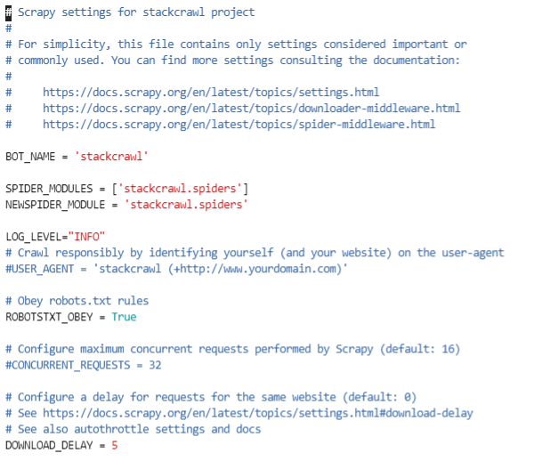
Before Crawling - Understanding settings.py
Avoid getting banned
rotate your user agent from a pool of well-known ones from browsers (google around to get a list of them)
disable cookies (see COOKIES_ENABLED) as some sites may use cookies to spot bot behaviour
use download delays (5 or higher). See DOWNLOAD_DELAY setting.
if possible, use Google cache to fetch pages, instead of hitting the sites directly
https://doc.scrapy.org/en/latest/topics/settings.html
https://doc.scrapy.org/en/latest/topics/practices.html

Slide 13
Roadmap
{ ‘url’:<url 1>,
‘body’: <full text>}
.
.
{ ‘url’:<url n>,
‘body’: <full text>}
Website to be crawled
https://datascience.stackexchange.com/questions/
Jl file
Json lines
getquestions

Slide 14
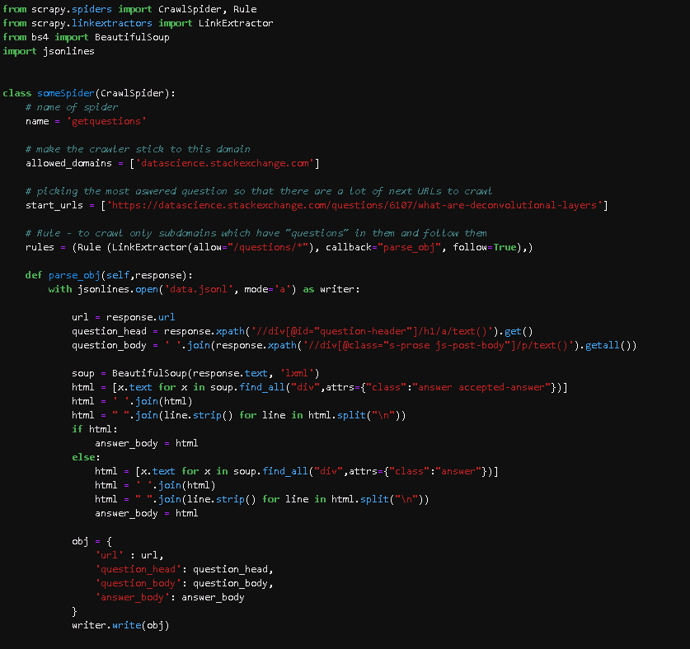
Getting URLs to Crawl
CODE
Where is it ?
/data/team<ID>/crawler/stackcrawl/stackcrawl/spiders/body_scrapy.py
Command to run
scrapy crawl getquestions

Slide 15
Getting URLs to Crawl
CODE
Where is it ?
/data/team<ID>/crawler/stackcrawl/stackcrawl/spiders/body_scrapy.py
Command to run
scrapy crawl getquestions

Slide 16
Getting URLs to Crawl
CODE
Where is it ?
/data/team<ID>/crawler/stackcrawl/stackcrawl/spiders/body_scrapy.py
Command to run
scrapy crawl getquestions

Slide 17
Getting URLs to Crawl
CODE
Where is it ?
/data/team<ID>/crawler/stackcrawl/stackcrawl/spiders/body_scrapy.py
Command to run
scrapy crawl getquestions

Slide 18
Getting URLs to Crawl
CODE
Most important variable
Xpath = gives location of the element on a page !
Use inspect element to get it
Any modern browser should be able to do it
Here I use beautifulsoup -
For finer control on the page
And getting the accepted-answer

Slide 19
View Your Crawled Data
data.jsonl
Every line is a dictionary or in json format
It will have 4 keys – url, question_head, question_body, answer_body
These keys contain what is crawled.

Slide 20
Moving Forward
The output of the scraper is not perfect as we see some unorthodox characters like \r, \n or \t.
We would first need to clean what we retrieved by removing unwanted characters. For example, we could replace \t characters to a space with a simple content.replace('\r', ' ‘)
Change LOG_LEVEL=“INFO”

Slide 21
Useful Links -
How to scrape websites in 5 minutes with Scrapy?
https://blog.theodo.fr/2018/02/scrape-websites-5-minutes-scrapy/
Use Scrapy to Extract Data From HTML Tags
https://www.linode.com/docs/development/python/use-scrapy-to-extract-data-from-html-tags/

Slide 22
Common Crawl
“We gather data, We aggregate it, You utilize it and it’s all free” - Motto
The data is open source
A good source to get seed URLs
They have a search engine for URLs
http://urlsearch.commoncrawl.org/
Homepage - https://commoncrawl.org/

Slide 23
Getting URLs from CC
Search your domain name
Download json which has URLs !
Done
Now crawl those URLs
P.S. – It might not have everything you want. But it will give you a set of good seed URLs

Slide 24
What to do next ?
Play around with this code template!
If needed crawl more data from the page - users, number of votes, comments . . .

